Slide 1

Working with TensorFlow
Notes:
‹#›

Slide 2
Objectives
Understand the basic of TensorFlow
The application of TensorFlow
Working with TensorFlow
‹#›
Notes:
‹#›

Slide 3
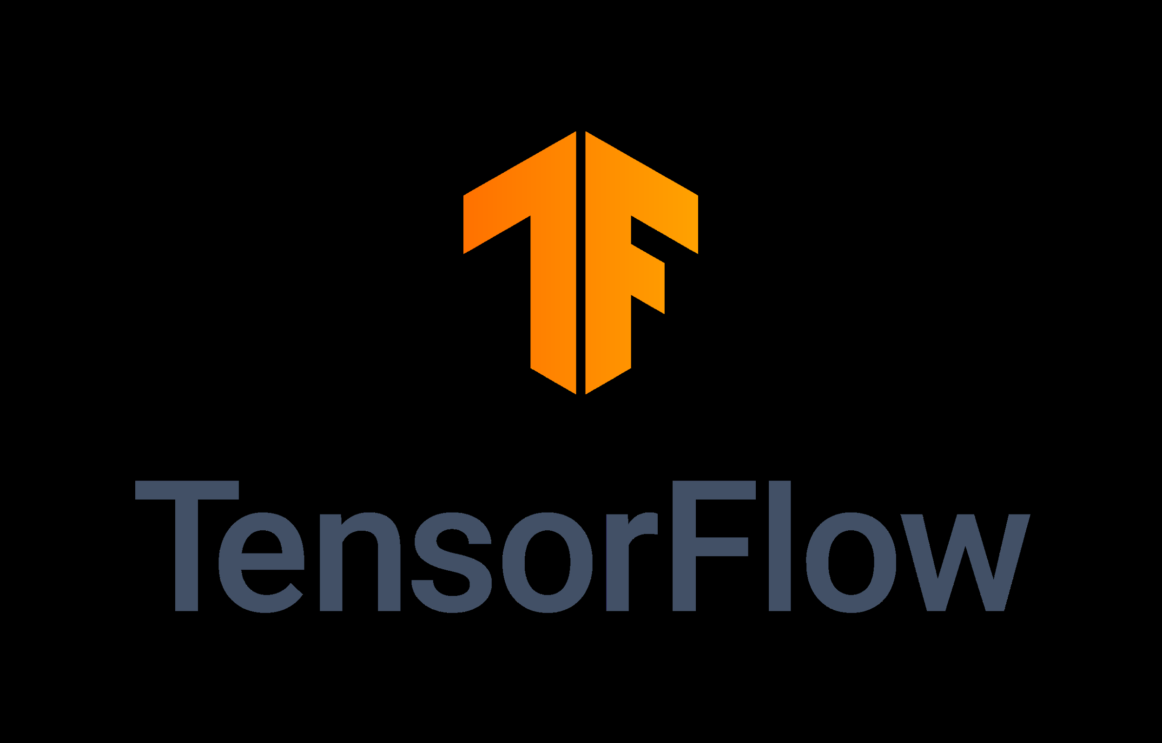
TensorFlow
TensorFlow is an end-to-end open source platform for machine learning
TensorFlow makes it easy for beginners and experts to create machine learning
Focus on training and inference of deep neural networks.
‹#›
Working with TensorFlow
Notes:
‹#›

Slide 4
TensorFlow
TensorFlow was developed by the Google Brain team for internal Google use in research and production.
It supports the following:
Multidimensional-array based numeric computation (similar to NumPy)
GPU and distributed processing
Automatic differentiation
Model construction, training, and export
‹#›
Working with TensorFlow
Notes:
‹#›

Slide 5
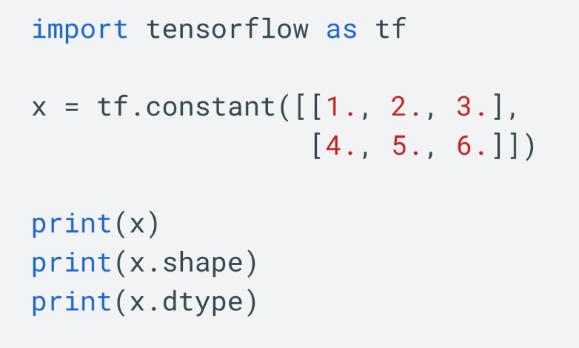
TensorFlow
TensorFlow operates on multidimensional arrays or tensors represented as tf.Tensor objects. Here is a two-dimensional tensor:
Tensor.shape: the size of the tensor along each of its axes.
Tensor.dtype: the type of all the elements in the tensor.
‹#›
Working with TensorFlow
Notes:
‹#›

Slide 6
TensorFlow
TensorFlow can be used in a wide variety of programming languages, including Python, JavaScript, C++, and Java
TensorFlow can run on multiple CPUs and GPUs, TPUs (with optional CUDA and SYCL extensions for general-purpose computing on graphics processing units).
TensorFlow is available on 64-bit Linux, macOS, Windows, and mobile computing platforms including Android and iOS.
‹#›
Working with TensorFlow
Notes:
‹#›

Slide 7

TensorFlow
Tensor processing unit (TPU), an application-specific integrated circuit (ASIC, a hardware chip) built specifically for machine learning and tailored for TensorFlow.
TensorFlow's APIs use Keras to allow users to make their own machine learning models.
‹#›
Working with TensorFlow
Notes:
‹#›

Slide 8
TensorFlow
Keras is the high-level API of the TensorFlow platform. It provides an approachable, highly-productive interface for solving machine learning (ML) problems, with a focus on modern deep learning.
Keras covers every step of the machine learning workflow, from data processing to hyperparameter tuning to deployment.
It was developed with a focus on enabling fast experimentation.
‹#›
Working with TensorFlow
Notes:
‹#›

Slide 9
TensorFlow
The core data structures of Keras are layers and models. A layer is a simple input/output transformation, and a model is a directed acyclic graph (DAG) of layers.
Layers: the tf.keras.layers.Layer class is the fundamental abstraction in Keras. A Layer encapsulates a state (weights) and some computation (defined in the tf.keras.layers.Layer.call method).
‹#›
Working with TensorFlow
Notes:
‹#›

Slide 10
TensorFlow
Models is an object that groups layers together and that can be trained on data.
The tf.keras.Model class features built-in training and evaluation methods:
tf.keras.Model.fit: Trains the model for a fixed number of epochs.
tf.keras.Model.predict: Generates output predictions for the input samples.
tf.keras.Model.evaluate: Returns the loss and metrics values for the model; configured via the tf.keras.Model.compile method..
‹#›
Working with TensorFlow
Notes:
‹#›

Slide 11
TensorFlow
Tensorflow Projects for Beginners
Driver Demand Prediction Project
Fake News Classification with TensorFlow
Plant Species Identification
Speech Emotion Recognition using TensorFlow
Ultrasound Nerve Segmentation
Time Series Forecasting.
‹#›
Working with TensorFlow
Notes:
‹#›

Slide 12
TensorFlow
Tensorflow Machine Learning Projects for Aspiring Data Scientist:
NLP based ChatBot
Dogs and Cats Classification with TensorFlow
Object Detection Machine Learning Project with TensorFlow
Real-time Image Animation Project
Plant Disease Detection Robot
Reinforcement Learning Game Player employing TensorFlow
‹#›
Working with TensorFlow
Notes:
‹#›

Slide 13
TensorFlow
Advanced TensorFlow Machine Learning Projects:
Lung Cancer Detection using TensorFlow
Gender Recognition Using Voice
Detecting Spam using TensorFlow
Optical Character Recognition using TensorFlow
Face Recognition using TensorFlow
Breast Cancer Classification Project using TensorFlow
Real-time Hand Gesture Recognition using TensorFlow
‹#›
Working with TensorFlow
Notes:
‹#›

Slide 14
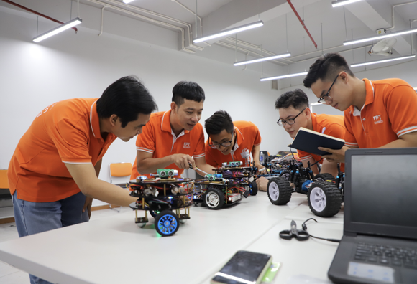
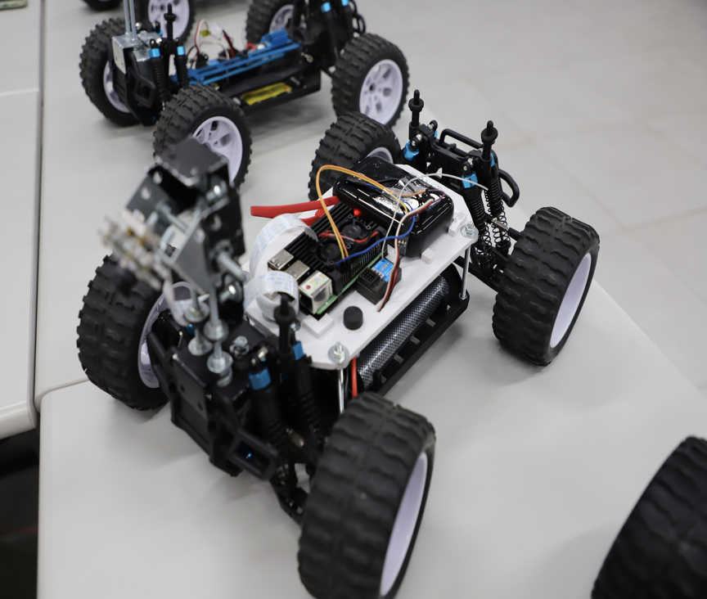
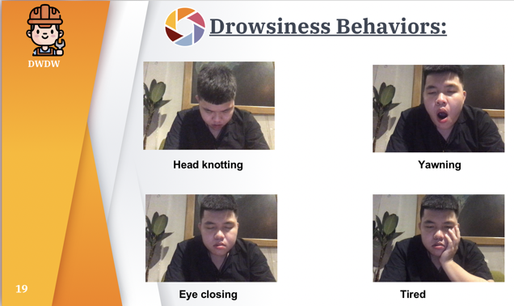
FPTU’s Projects
‹#›
Working with TensorFlow
Notes:
‹#›

Slide 15
Summary
Understand the basic of TensorFlow
The application of TensorFlow
Working with TensorFlow
‹#›

Slide 16
Q & A
Working with TensorFlow
‹#›

